Slide 1


Slide 2
Lecture : 06
Web forms and types of Business Data

Slide 3
Web forms
Web forms are interactive parts of a website where users can enter data and submit it.
Think of a feedback form, login form, or registration form.
Forms collect information like name, email, phone number, feedback, or orders.
Purpose: Web forms are widely used in business applications to collect and manage data from users.

Slide 4
Real-life Examples of Web Forms in Business
E-commerce Website:
Form to collect shipping details (name, address, phone).
Example: Amazon checkout form.
Job Application:
Collect candidate information (resume, contact details).
Newsletter Signup:
Collect email addresses to send updates.
Customer Feedback:
Collect ratings and comments to improve services.

Slide 5
Customer Data & Business Information Flow
When a user fills out a web form:
Customer enters data on the website.
Form sends data to the server.
Server processes and stores it in a database.
Business can access and use this information for operations, marketing, or decision-making.

Slide 6
Real-life Flow Example
E-commerce order form:
Step 1: Customer enters name, address, and order details.
Step 2: Clicks Submit button.
Step 3: Data goes to database.
Step 4: Business sees the order and ships the product.
This is called business information flow – from customer input → processing → business action.

Slide 7
Purpose of web forms in business applications
Web forms are used to:
Collect Data
Example: Registration form for a webinar collects name, email, phone number.
Automate Business Processes
Example: Customer fills support request form, system creates ticket automatically.
Enhance Customer Interaction
Example: Feedback forms to improve service quality.

Slide 8
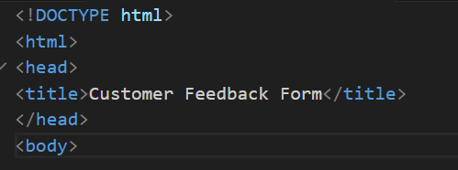
Cont…
Basic HTML Structure
This part creates the basic structure of the webpage.

Slide 9

Form heading
This displays the title of the form on the webpage.
<h2> creates a heading to show the purpose of the form.

Slide 10

Creating the Form Container
This is the main form element where all input fields will be placed.
<form> - container for form fields
action - where the data will be sent
method="post" - sends form data securely to the server

Slide 11

Name input fields
This allows the user to enter their name.
<label> - describes the input field
<input type="text"> - text input box
required - user must fill the field before submitting

Slide 12

Email input fields
This field collects the customer's email address.
type="email" ensures the user enters a valid email format

Slide 13
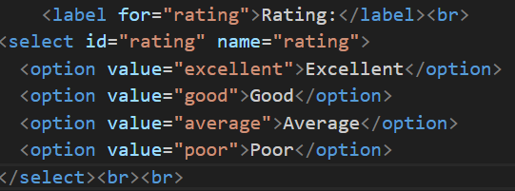
Rating drop down
<select> - creates a dropdown menu
<option> - options inside the dropdown

Slide 14
Comments text area
This allows the user to write detailed feedback.
<textarea> allows multi-line text input
rows and cols define the size of the text box

Slide 15
Submit button
This button submits the form data.
<button> creates a clickable button
type="submit" sends the form data to the server

Slide 16
Types of business data
Business data are important because apps and websites often store and process this information to help businesses operate efficiently.
1. Customer Information
This data contains details about the people who use the business’s website or mobile app.
Examples:
Name Email address
Phone number Delivery address
Login credentials (username/password) Purchase history

Slide 17
Why Customer Information is Important in Apps
Helps create user accounts When people enter their name, email, and password, the app can create their personal account. This lets them log in and use the app anytime.
Enables personalized services The app can show things the customer likes. For example, it may suggest products based on what the customer searched or bought before.
Example
In an e-commerce app, when a user signs up and enters their details, the app saves that information. The next time the user opens the app, they can log in and shop easily without entering the details again.

Slide 18
2. Orders and Inquiries
This data records transactions and questions from customers.
Examples of Orders:
Product ordered
Quantity
Order date
Payment status
Delivery status

Slide 19
Why Orders and Inquiries Are Important in Apps
Tracks sales and transactions The app records what customers buy and when they buy it. This helps the business know how many products are sold.
Helps manage inventory and deliveries When an order is placed, the system updates the stock (available products) and helps arrange delivery to the customer.
Example
When a person orders food from a mobile food delivery app, the app saves details like food item, quantity, address, and payment. This information helps the restaurant prepare the order and deliver it to the customer

Slide 20
3. Feedback and Surveys
This data collects customer opinions and satisfaction levels.
Examples:
Product ratings (1–5 stars)
Reviews and comments
Survey responses
Customer satisfaction scores

Slide 21
Why Feedback and Surveys Are Important in Apps
Helps businesses improve products and services Customer feedback tells the business what people like or dislike, so they can make their products or services better.
Shows customer needs and problems Feedback helps the business understand what customers want and what problems they face while using the product or app.
Example
After buying something, the app may ask the user to give a rating or write a review. This helps the business know if the customer is satisfied or not.

